Slide 1
Rocket ship Predictor
By: Cosma T. KUFA
Powered by:
Notes:
Targeted for investors looking to invest in companies that have raised at least one round of founding

Slide 2
Overview: Question
Can we predict which companies will end up closing or have a significant event ( ipo or acquisition)?

Slide 3
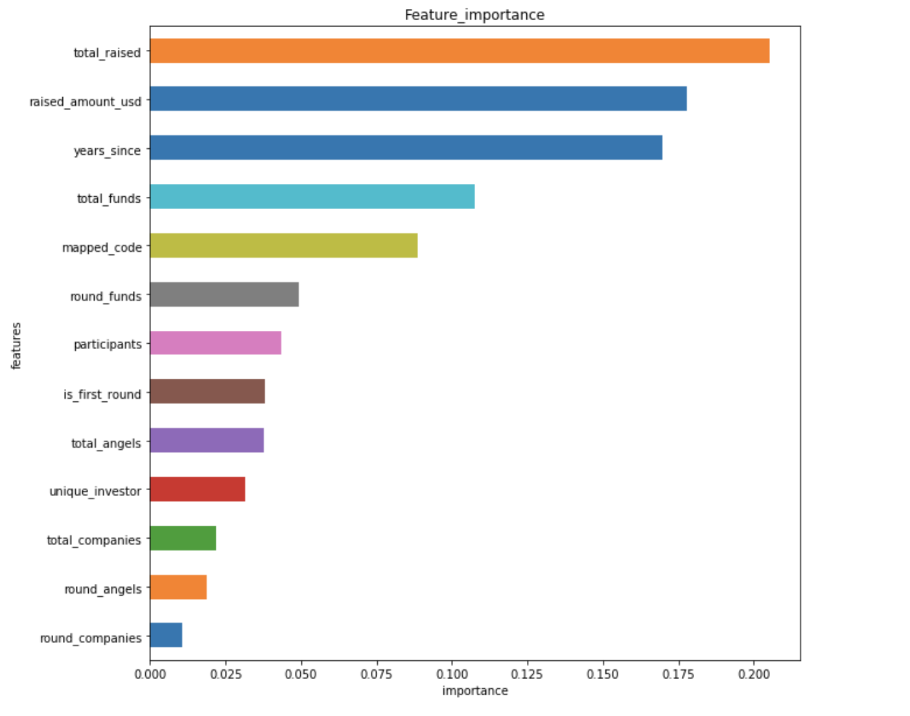
Findings: Data & Feature Importance
Features
Investors
Funds
People
degrees
Company
offices
Funding Rounds
Investments
Companies
relationships
Target
Exit
Acquired
IPO
Closed
Powered by:

Slide 4
Results: Model performance: F1 Score
Base Case: Invest in Every Company
Score = .2
Model: Random Forest
Score = .3
50% performance improvement
Powered by:

Slide 5
Results: Precision by Round
TYPES OF FUNDING
GRANT
CONVERTIBLE
ANGEL
SEED
A
B
C
D
E
F
G
PARTIAL
PRIVATE_EQUITY
DEBT_ROUND

Slide 6
Results: Cost Benefit Analysis
Cost Benefit increased by 200%
Powered by:
Powered by:

Slide 7
Future: Data & Feature Importance
Features
Investors
Funds
People
degrees
Company
offices
Funding Rounds
Investments
Companies
relationships
Status Model
Exit
Acquired
IPO
Closed
Time Model
Predicted time to event in model #1
Powered by:

Slide 8
Investing
"What's nice about investing is you don't have to swing at pitches.
You can watch pitches come in one inch above or one inch
below your navel and you don't have to swing. No umpire is
going to call you out. You can wait for the pitch you want.”
-Warren Buffett

Slide 9
THANKS
DEMO : Coming Soon to an Internet near you
Github: https://github.com/cosmakufa/capstone

Slide 11
Why Investing Matters
Inflationary economy
Pro: Inspires economic growth and economic productivity
Con: Dollar loses purchasing power over time
Investment Vehicles
Treasury Bonds
Property
Appreciating objects(Gold, Art, etc.)
Companies

Slide 12
FINDINGS: Performance & Features
The model generated a 50% increase in performance
Number of investors not
Notes:
"The stock market is a no-called-strike game. You don't have to swing at everything - you can wait for your pitch. The problem when you're a money manager is that your fans keep yelling, 'swing, you bum!'"

Slide 13
FINDINGS
The model generated an ROI of *
Naïve model generated on ROI of *
Metric: F1 Score (precision score and recall score)
The model generated ** of capital loss
The model generated ** opportunity cost
Funds average performance
Notes:
"The stock market is a no-called-strike game. You don't have to swing at everything - you can wait for your pitch. The problem when you're a money manager is that your fans keep yelling, 'swing, you bum!'"

Slide 14
How it works

